Slide 1
JOINs

Slide 2
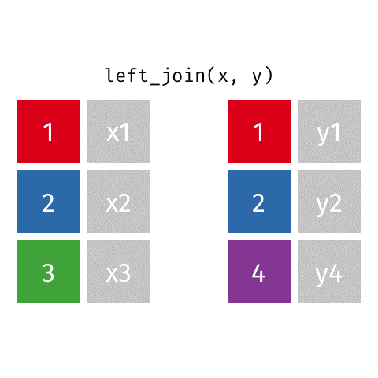
LEFT OUTER JOIN
Every tuple in left table must appear in result
If no matching tuple
Padded with NULL values for attributes of right table

Slide 3

RIGHT OUTER JOIN
Every tuple in right table must appear in result
If no matching tuple
Padded with NULL values for attributes of left table

Slide 4
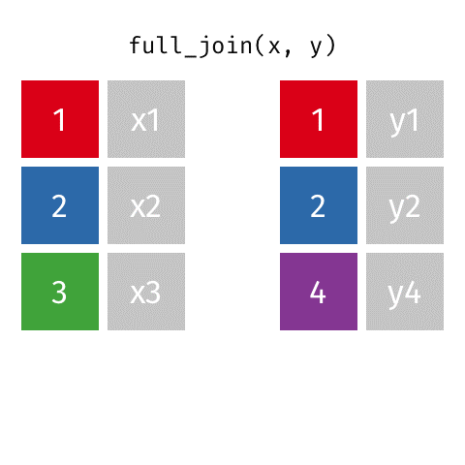
FULL OUTER JOIN – combines result if LEFT and RIGHT OUTER JOIN

Slide 5

INNER JOIN – joins two tables based on a common column, and selects records that have matching values in these columns

